Slide 1
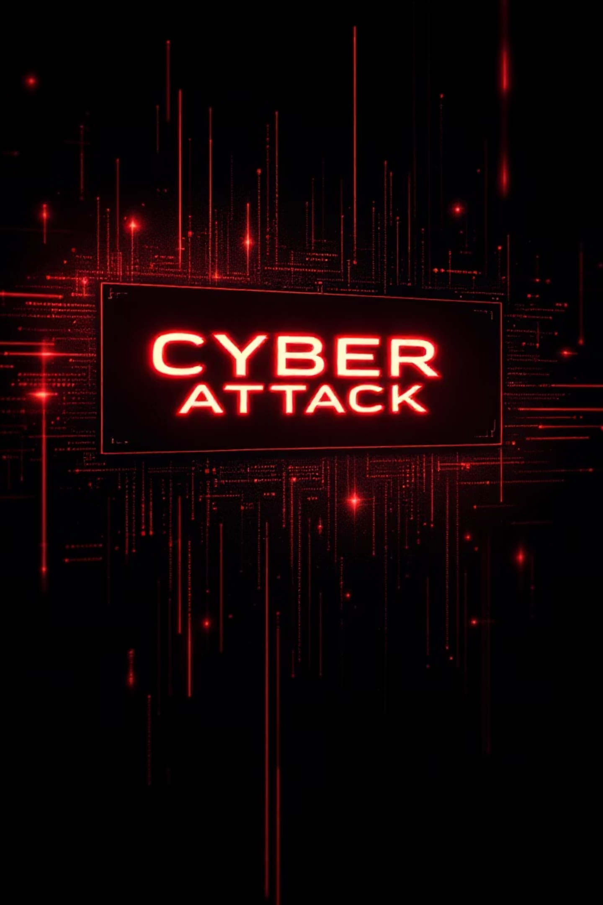
September 8, 2025: This Actually Happened
"Billions of npm downloads infected with crypto-stealing malware"
Popular packages like chalk, debug, and ansi-styles were compromised. 2.5 million downloads in just 2 hours.
The question we must ask: How could we have prevented this?

Slide 2

The Security Crisis
150K
46%
0
Malicious Packages
Python Packages
Pre-Install Scanning
Detected across package registries
Have known security issues
Currently exists in standard tools
Current reality: Install → Hope it's safe → Find out later. This is reactive, not proactive.
Our solution: Pre-installation security scanning

Slide 3
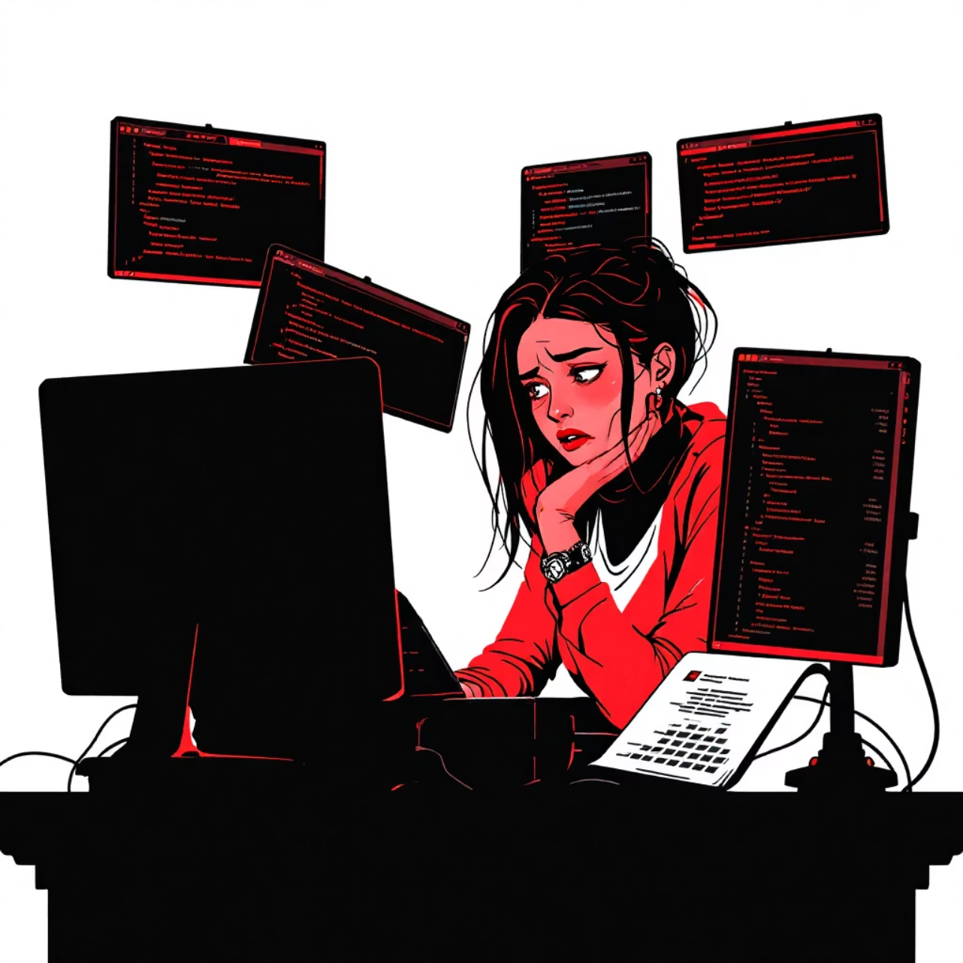
Meet Developer: The Overwhelmed Developer
Her Current Workflow
She checks three package managers manually every week:
npm list -g for Node packages
pip3 list for Python libraries
choco list for Windows tools
Time wasted: 30 minutes per week
Error rate: 20% (she forgets something)

Slide 4


The Transformation
Before: Manual Work
Three separate commands, three different outputs to parse. Takes 3+ minutes of repetitive work.
After: Unified Power
One command: cli list. Unified table appears instantly. All managers in ONE place.

Slide 5



"Works on My Machine" Problem
A team with 50 dependencies faces version chaos:
Dev A
Dev B
Dev C
react@17 (old version)
react@18 (new version)
react@17.5 (medium version)
Result: Different behavior leads to bugs. Current fix takes 2+ hours of debugging.
What if there was one command to solve this?

Slide 6



Perfect Team Consistency in 30 Seconds
Export
cli export-manifest team.json
Captures exact versions
Share
Send JSON file to team members
Import
cli import-manifest team.json
All exact versions installed

Slide 7
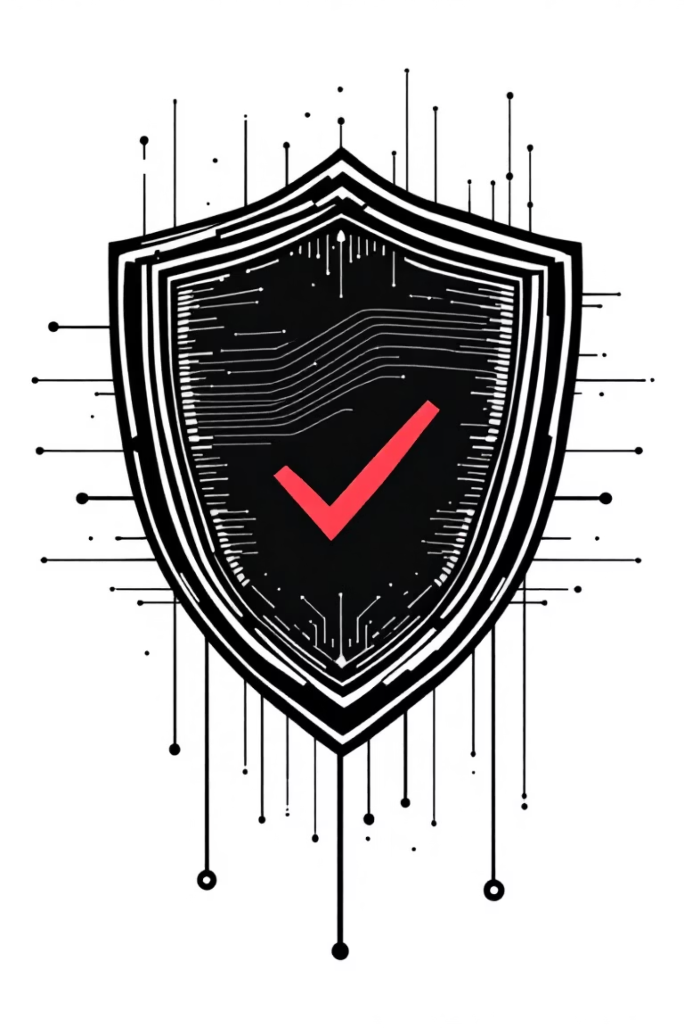
Security Scanning in Action
01
02
Scan Before Install
VirusTotal Integration
cli install package --scan
Checks against 70+ antivirus engines
03
Instant Results
✅ SAFE or ❌ MALICIOUS - BLOCKED
Catches attacks BEFORE they hurt your system

Slide 8

Built on Solid Research
Academic Foundation
Endor Labs 2025 Report
Datadog DevSecOps Report
USENIX Supply Chain Research
20+ peer-reviewed papers
Demo 1 (Now)
Final (April)
✅ Core functionality
🔄 Complete system + thesis
1
2
3
Demo 2 (January)
🔄 Security + GUI

Slide 9
The Path Forward
The problem is real
September 2025 attack proves it
Our solution is practical
Demonstrated time savings
Prevents attacks proactively
Security scanning before installation
Ready for the Next Phase

